Slide 1
Securing FHIR with OAuth
Grahame Grieve
FHIR Developer Days
November 25, 2014

Slide 2
Overview
Overview of Security Landscape for FHIR
About OAuth and issues
I’ll take questions as we go

Slide 3
Overview
Securing an API is both painful and necessary
You want to secure it just enough
The threat model is changing rapidly
There’s no “get it right up front”
There’s a rapid response arrangement with regard to security in FHIR

Slide 4
Overview
Communications Security
Authentication
Authorization/Access Control
Audit
Digital Signatures
Attachments / Narrative
Security labels

Slide 5
Communications
Current Practice
secure public, insecure ‘private’ communications
FHIR Recommends always using SSL (/ TLS)
Only TLS 1.2 recommended now, but not supported on some platforms
Need to use Client Certificates to get meaningful security (anti-Man in the Middle)
Post-Snowden, this should get easier

Slide 6
Auth vs Auth
Authentication
Who is at the other end (machine, software, human)?
Authorization
What is the (process) allowed to do?
Confusing for many people, because you generally have to do the first to decide the second

Slide 7
Authentication
Who is the other end of the communication channel?
Shared Secret (e.g. password)
Token (e.g. client certificate)
Biometrics (if user physically available)
There are lots of reasons why different solutions are appropriate
FHIR does not fix to any particular one

Slide 8
Authorization
In FHIR terms, what resources can the user see / change?
What happens when they try to access something they can’t see? Change something they can’t change?

Slide 9
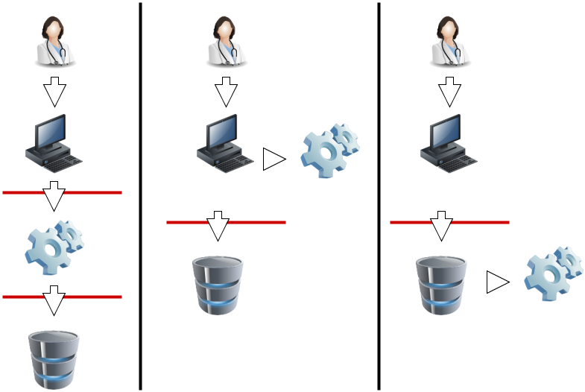
Authorization

Slide 10
Authorization
In FHIR terms, what resources can the user see / change?
What happens when they try to access something they can’t see? Change something they can’t change?
Difficult: the user can see part of the resource
More difficult: the narrative is frequently denormalised

Slide 11
Audit
SecurityEvent resource records events
Based on ATNA (IHE spec)
The RESTful API allows create, but not update or delete (= ATNA)
Search / read allows users to process an event log (functionality beyond ATNA)

Slide 12
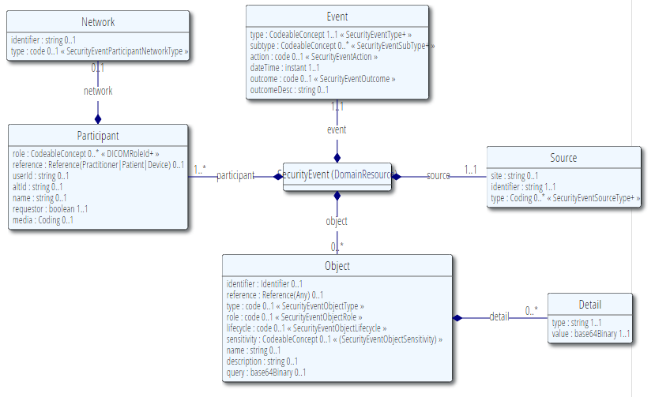
Audit

Slide 13
Digital Signatures
Allow for testing about whether content has changed
Two places where signatures catered for:
Sign a bundle (enveloped signature – sign what’s in the bundle)
Sign a provenance (detached signature – sign what the provenance refers to)

Slide 14
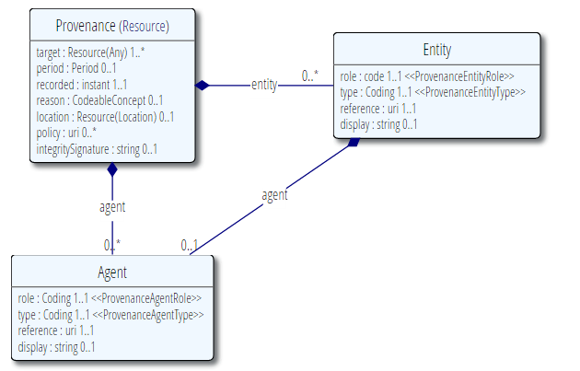
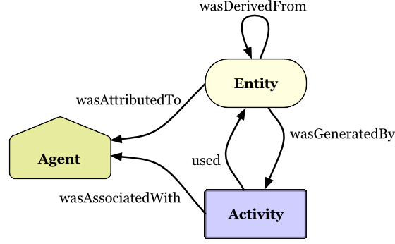
Provenance

Slide 15
Provenance
Code | Definition
enterer | A person entering the data into the originating system
performer | A person, animal, organization or device that who actually and principally carries out the activity
author | A party that originates the resource and therefore has responsibility for the information given in the resource and ownership of this resource
verifier | A person who verifies the correctness and appropriateness of activity
attester | A verifier who attests to the accuracy of the resource
informant | A person who reported information that contributed to the resource
source | An information source from which the portions of the resource are derived
cc | A party, who may or should receive or who has received a copy of the resource or subsequent or derivative information of that resource
application | An application with a user interface that interacts with a person
daemon | A background process that transfers information from one place or form to another

Slide 16
Digital Signatures
There are many valid reasons for the data to change
Syntax variations & JSON vs XML
Code translations
Changing security access labels
Relocation of resources
Ongoing content editing

Slide 17
Digital Signatures
Which format?
XML Digital Signature vs JSON Web Token
What canonicalization?
Sign JSON vs XML vs something else?
Current plan:
Describe canonical forms for XML and JSON
There is no syntax variation – it’s all data
Can sign with either JWT or XML DigSig
? Support for canonicalisation of references

Slide 18
Attachments
Attachments may include active content
Scripts, executable code, exploits, malicious content
Might run in a very privileged environment
Attachments may be references to external content
Allows clinical information to be tracked
Applications might leak information when accessing it

Slide 19
Attachments
Maintain a whitelist of allowed content types and content servers
Scrub http headers scrupulously when accessing content (internal proxy)
http://smartplatforms.org/2014/04/security-vulnerabilities-in-ccda-display/

Slide 20
Narrative
Narrative in resources presents similar issues (HTML is very active content)
For security and clinical safety reasons, no active content is allowed
Object, embed, script tags, etc
Enforced by schema / reference implementations
But image references are still allowed – so care is still required

Slide 21
Security Labels
A tag attached to the resource
Makes explicit statements about the resource content
Might be based on the resource content or not
Used by access control engine
Can convey obligations associated with the data
These are binding on any FHIR implementation

Slide 22
Core Security Labels
Confidentiality Code
Celebrity / Staff
Keep information from patient
Contact/Employment Details Confidential
Diagnosis-related confidentiality
Author Consent needed
Delete After Use
Do Not Re-use
Break The Glass

Slide 23
OAuth
Server must make decisions about security
Server has to identify client and give it privileges
Classically, done by a trusted connection
Server identifies client by network address, implicit trust, or client certificate
Server trusts client to identify the user
Server assigns role-based privileges to client / user

Slide 24
OAuth
Static – user has no operational control
User has to trust their agent completely
User cannot choose agents
The administrator is in control
OAuth puts the user back in control
User decides how much they trust their agent
User can only grant access that they have

Slide 25

OAuth
OAuth also delegates authentication of the user to the server, not the client

Slide 26
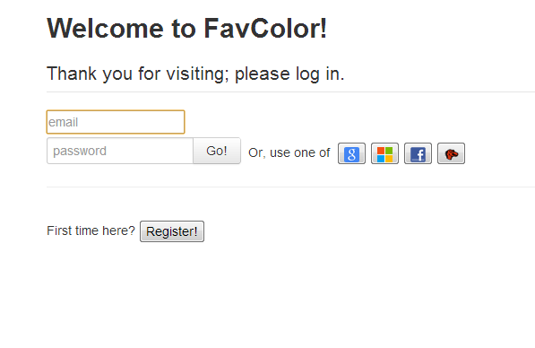
Oauth - Example

Slide 27
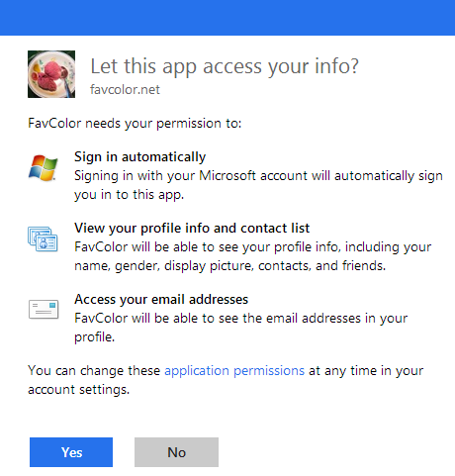
Oauth - Example

Slide 28
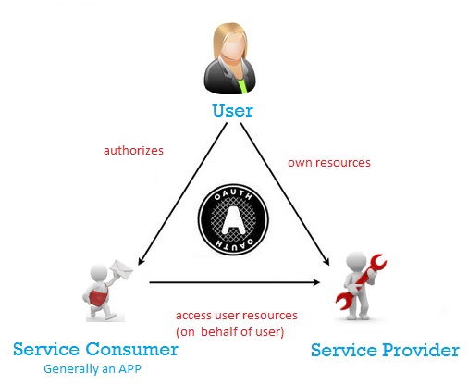

Slide 29
User Resources?
User Information
Email Address
Real world Identifying Information (name, etc)
Google/Facebook friend list
User specific services
Post to facebook wall
Storage (e.g. DropBox)
Health Care information

Slide 30
OAuth Parties
User
User who wants to achieve something
Service Provider
Can authenticate the user (password etc)
Has things the user owns
Service Consumer
Needs to use User’s resources (e.g. for the user)
Trusted by the service provider and the user

Slide 31
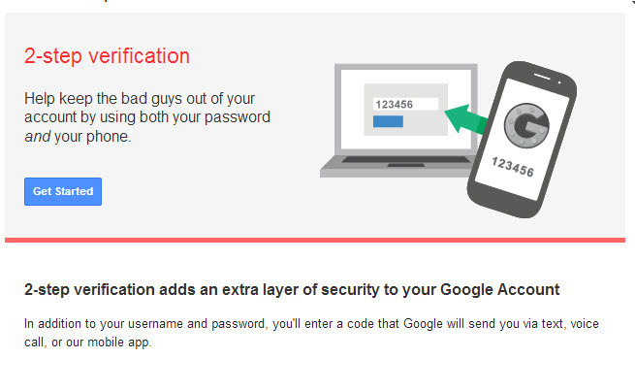
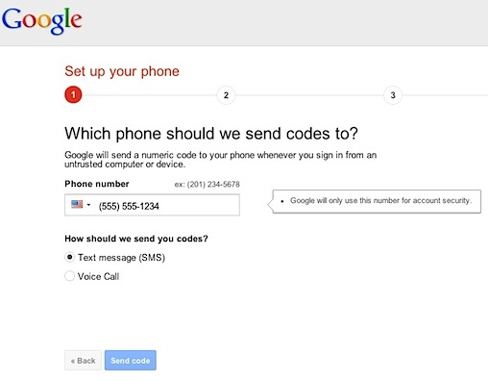
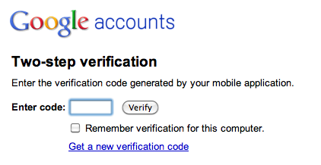

Slide 32
OAuth Parties
User
User who wants to achieve something
Service Provider
Can authenticate the user (password etc)
Has things the user owns
Service Consumer
Needs to use User’s resources (e.g. for the user)
Trusted by the service provider and the user

Slide 33
Authorization vs Authentication
Service Consumer doesn’t know who the user is
Just knows that the Service Provider authorises the consumer to do things on behalf of anonymous user
Which may include getting their identification
if service provider authenticated the user
And if the service provider as an API for that
And if the user allows it to be shared

Slide 34
Setting OAuth Up
There must be a private agreement between the service provider and the service consumer
The service provider gives the service consumer a secret (or 2) that the user doesn’t see
The secrets are used in the exchange protocol
Service consumer might not be secure

Slide 35
OAuth Flows
There are multiple “flows” – sequences of exchange. Most are variations of:
User prompts engagement
Consumer refers to User to provider (http address)
Provider authenticates user as it sees fit
Provider asks the user whether scopes are ok
Provider refers User back to consumer (http address) with a token
Consumer uses token to get access rights

Slide 36
OAuth
OAuth is a framework
Like FHIR
There’s lots of ways to use it
Every implementation is different

Slide 37
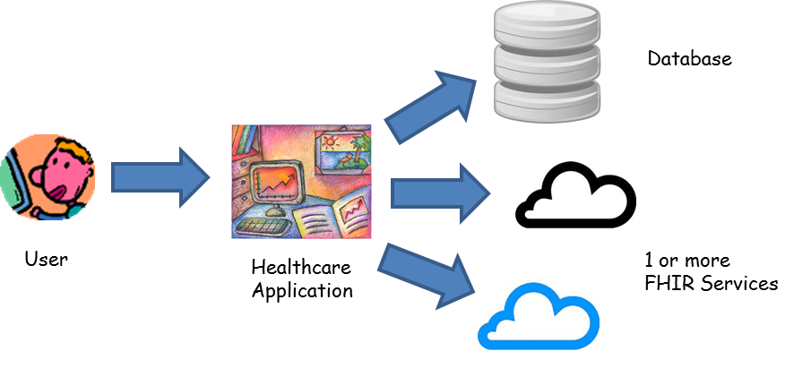
Using OAuth

Slide 38
Using OAuth
Consumer (client) delegates Authorization to Provider (server)
Server can delegate Authentication to another party (Double Layer OAuth)
Demonstration
http://www.healthintersections.com.au/?p=2108 (includes Josh Mandel’s excellent video)

Slide 39
Scopes
Service Consumer requests a set of permissions – “scopes”
Service Provider checks these with the user
Service Provider tells Service Consumer what permissions the user granted
All 3 parties have to agree on scopes

Slide 40
Possible Scopes
Access identifying information
Access to a particular patient compartment
Read access to all resources
Write access to a resource type
Create operation on Observation Resource
Read/write all medication resources
Mental Health related history

Slide 41
OAuth Pro’s & Cons
Dynamic Permission Assignment
Delegate User Authentication
Relatively Simple API
Can Compose amazing services
Framework not solution
Documentation confusing and byzantine
Errors obtuse and misleading
Not a full solution yet

Slide 42
Conclusion
This remains an ongoing area that will drive more new versions of the specification
We currently plan to migrate the SMART-On-FHIR security parts to FHIR once they are stable

